Slide 1



Cadmium Removal from Water with a Corn Biosorbent
By Melissa Jacquez
Environmental Engineering department Northern Arizona University
Mentor Dr. Fethiye Ozis

Slide 2

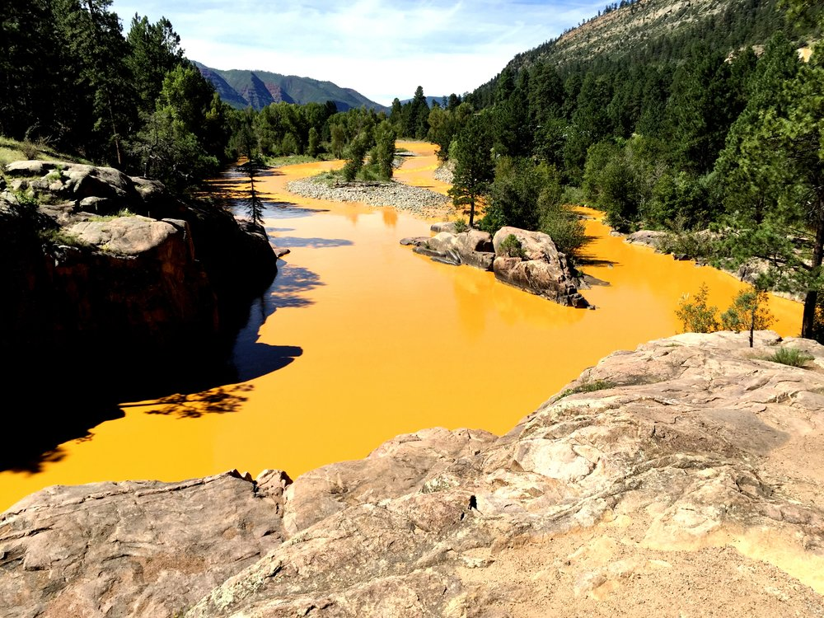
Importance of clean water
Mine spills effecting rural commutes
  Chenzhou mine spill (China)
  Tar Creek superfund site
  Kings mine spill
    Cd 36.1 μg/L to 138 μg/L
  Cadmium health effects
  Short term exposure:
    nausea, vomiting, diarrhea, muscle cramps, sensory disturbances, liver injury and renal failure
  Long term exposure:
    kidney, liver, bone and blood damage

Slide 3
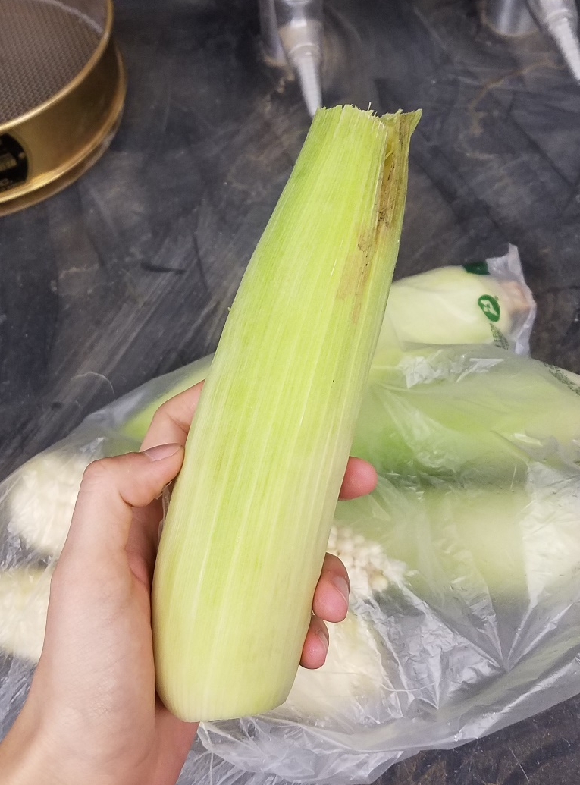
Bio-sorbents?
Biosorbents- tiny particles of any biological component that remove metals or nonmetals from a solution .
United States produces 120 million tons of biomass residue per year
Corn is a possible economically way to remove heavy metals from water.
Question: Do corn cobs work as a viable biosorbent to remove Cadmium from contaminated waters?

Slide 4
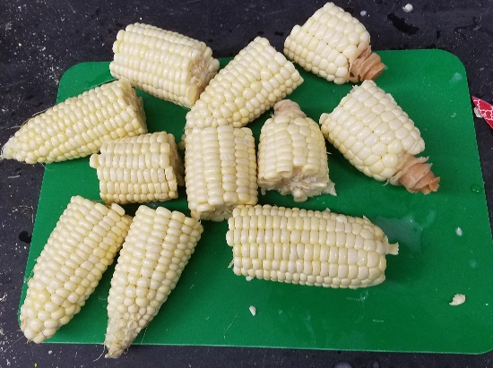
Data collection

Slide 5
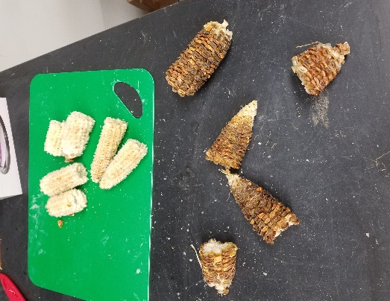

Slide 6
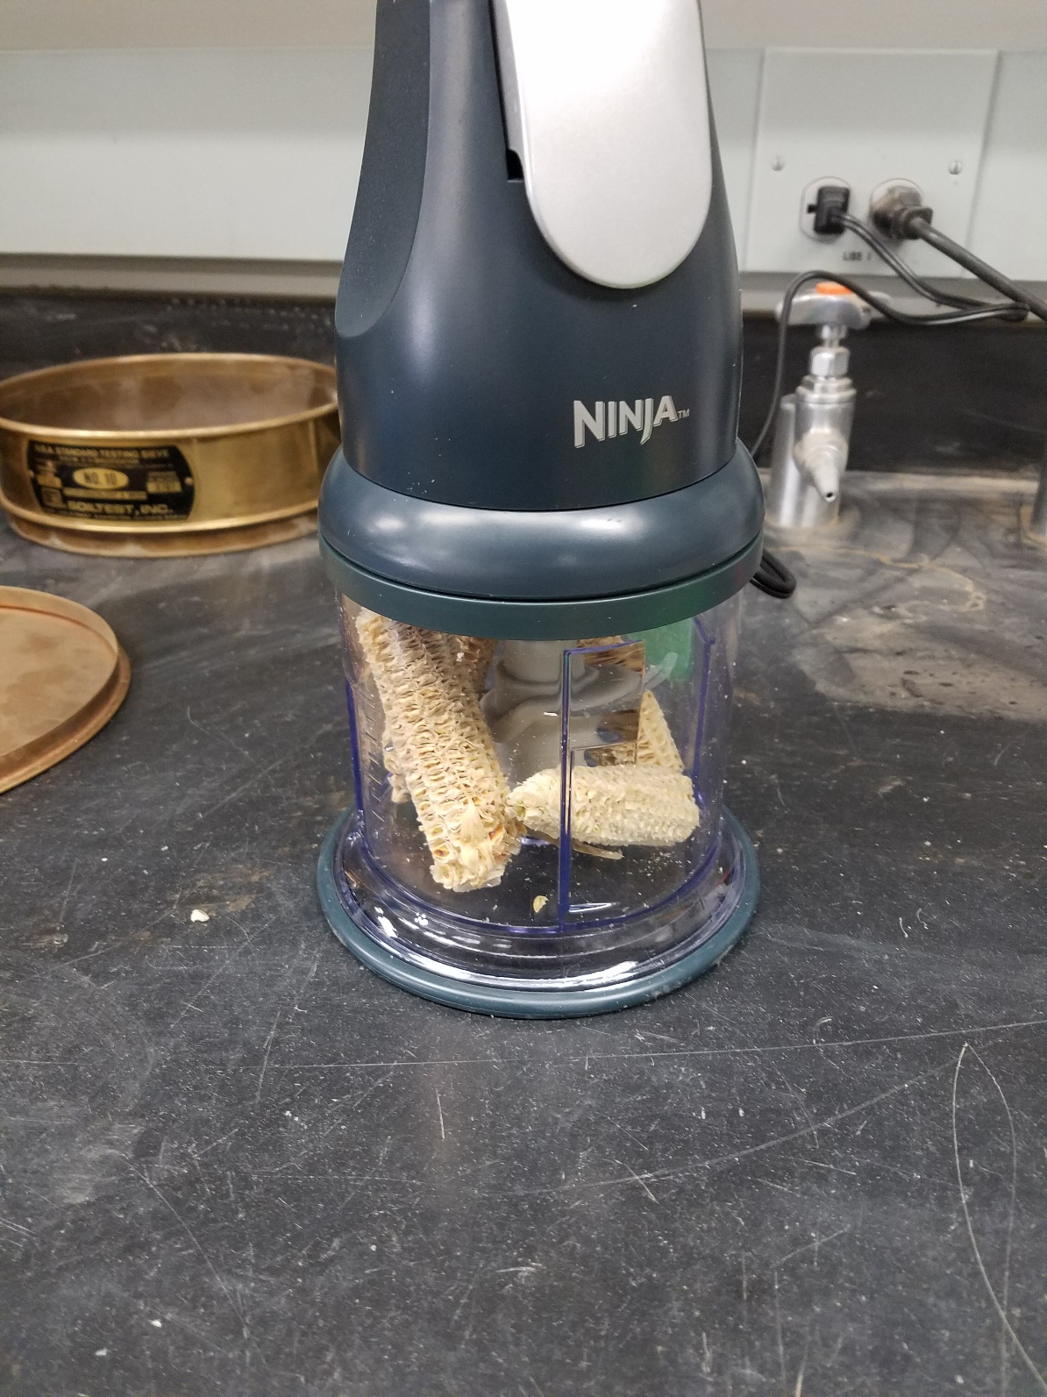

Slide 7
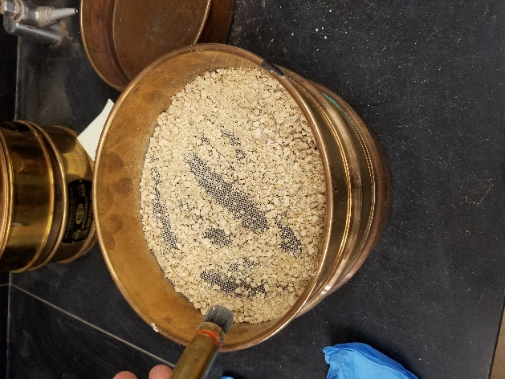

Slide 8
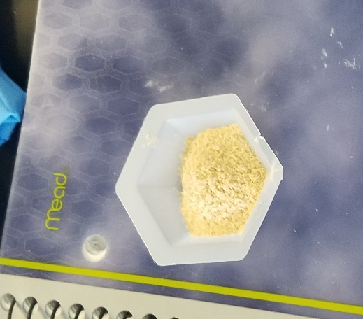

Slide 9
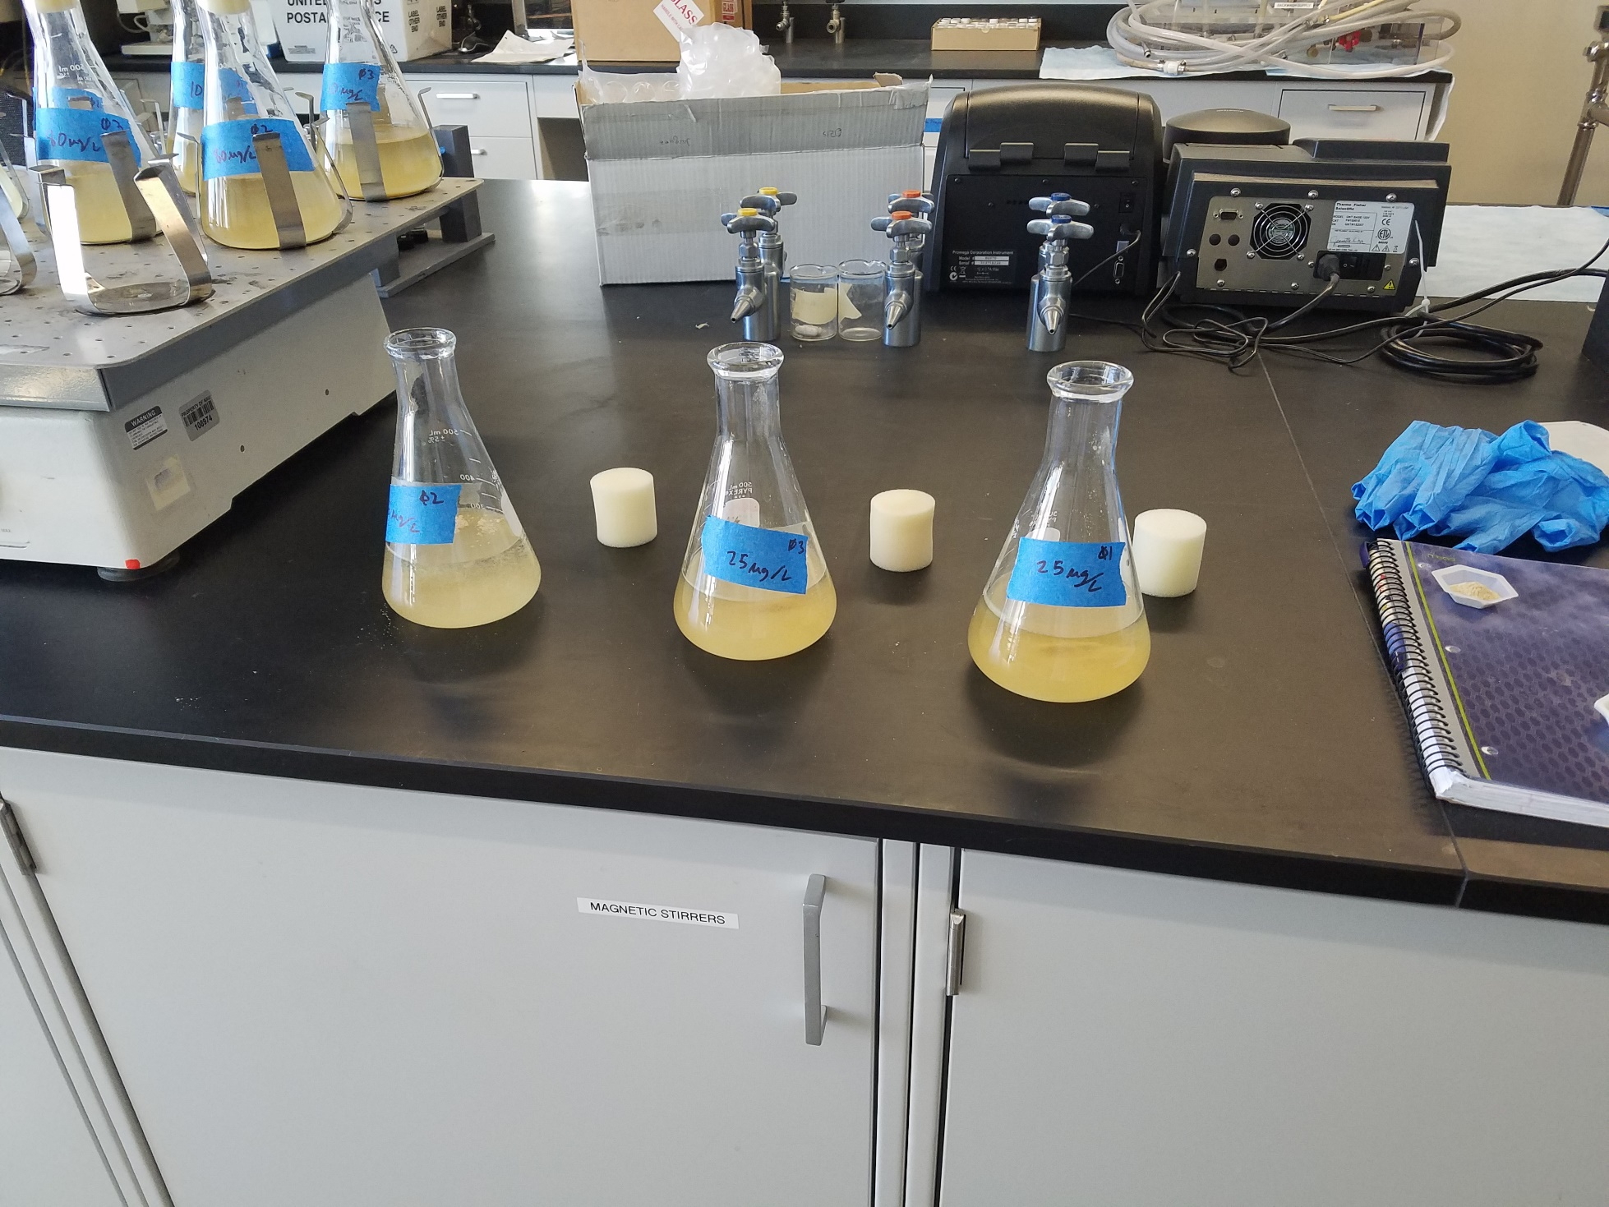
10 ug/l
25 ug/l
80 ug/l

Slide 10
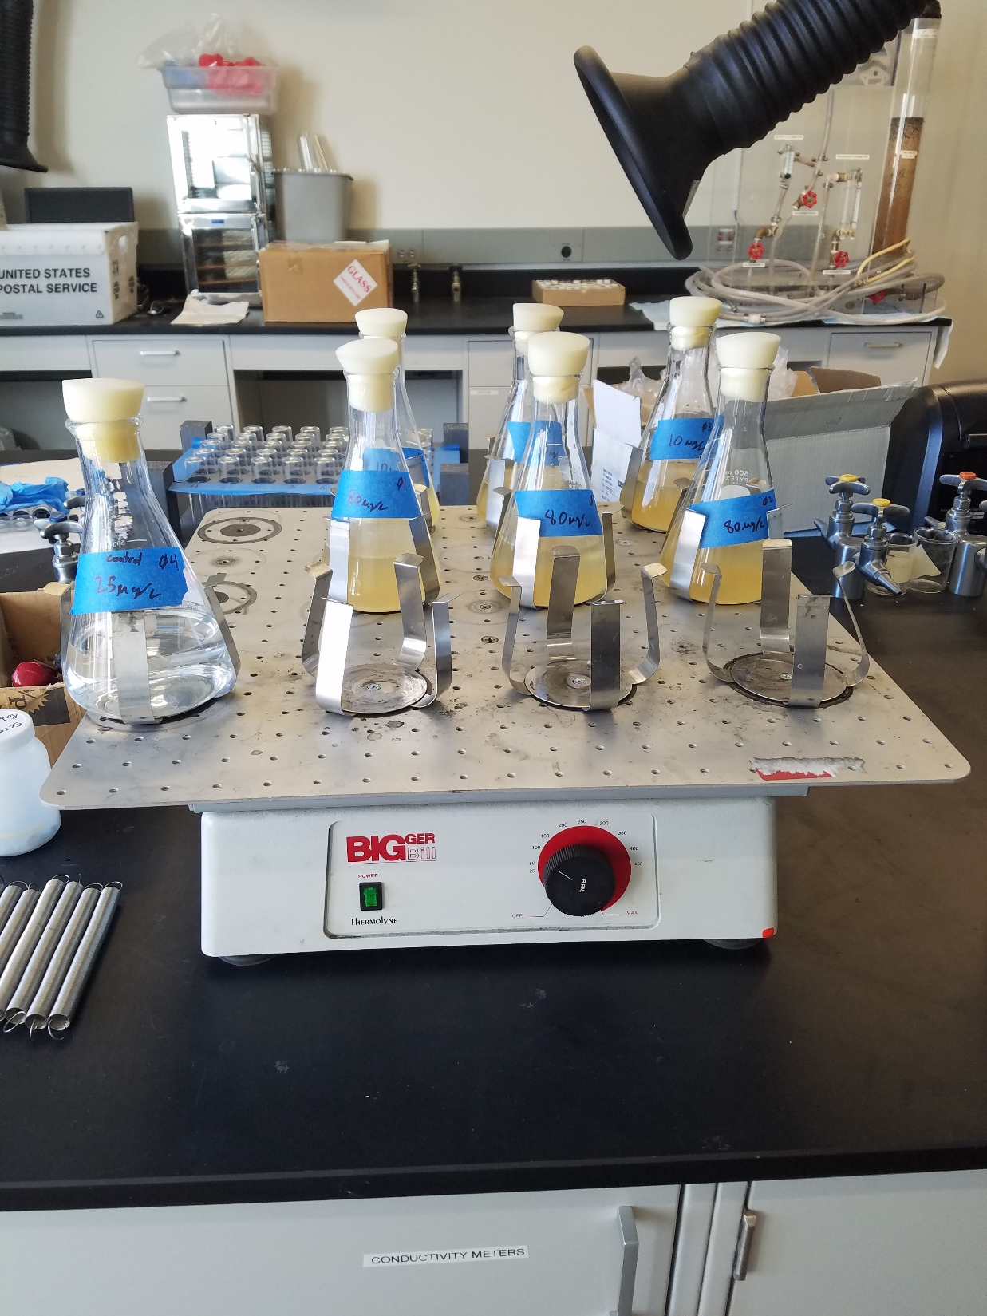

Slide 11
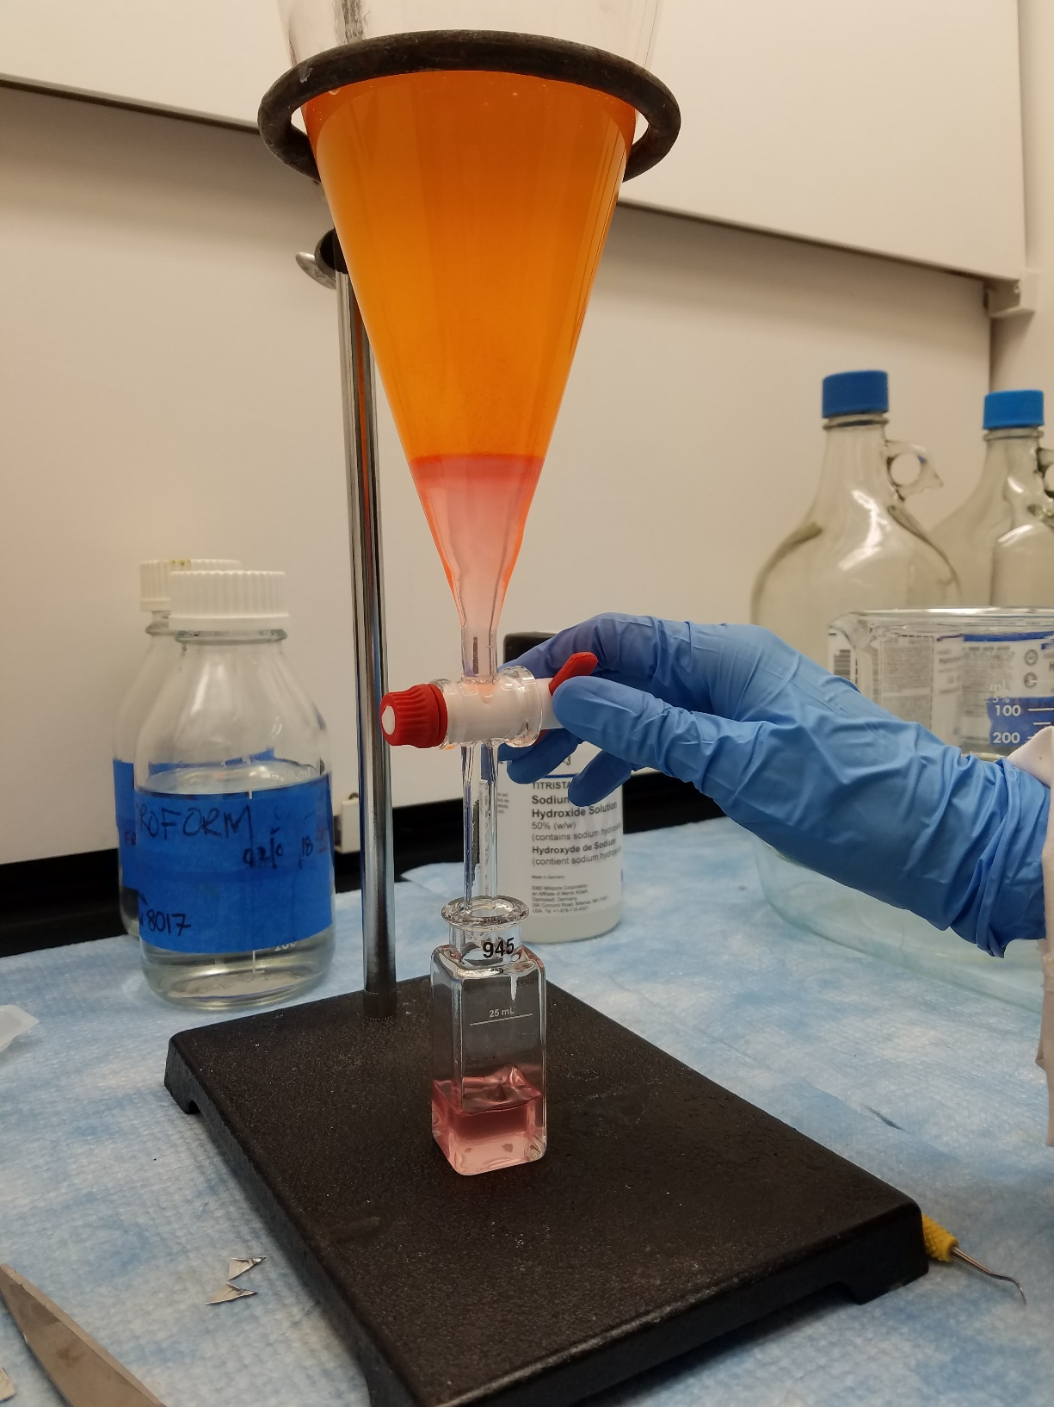

Slide 12
Analysis
Calibrated data points
 | Test 1 | Test 2 | Test 3
Ci (ug/L) | C_{f} (ug/L) | C_{f} (ug/L) | C_{f} (ug/L)
10 | 11.08 | 7.13 | 14.41
25 | 14.67 | 33.41 | 14.41
80 | 42.95 | 28.84 | 45.52

Slide 13
Conclusion
For higher concentrations corn is a viable biosorbent
Lower concentration did not see large sorption rates.
Is a viable bio sorbent for Cd but further research could be done on different parts of the corn and other heavy metals.
Initial concentration (ug/L) | Removal/Absorption Efficiency
10 | 9.0 %
25 | 41.8 %
80 | 51.1 %

Slide 14
Special thanks to
Dr. Ozis
Nasa Space Grant
Any Questions?

